Slide 1
MID DEFENSE “Text-to-Image Generation”
Neha Shrestha (24287 / 7th Semester / 2076)
Norden Ghising Tamang (24290 / 7th Semester / 2076)

Slide 2
CHAPTER - 1: INTRODUCTION

Slide 3
1.1. INTRODUCTION
Generative AI is subfield of AI
Generates new data such as images, texts, videos, audios, etc.
Generative AI learns probability distribution and use it for inference
Diffusion Models a popular approach
Model is based on Latent Diffusion

Slide 4
1.2. PROBLEM STATEMENT
Data scarcity can be solved through Generative AI.
Text-to-image model enhances understanding and communication visually.
Idea can be represented quickly through the model without technical expertise.

Slide 5
1.3. OBJECTIVE
To transform textual descriptions into visually appealing images.
To ensure the generated images are coherent and contextually accurate.
To provide a user-friendly interface for users to input text and retrieve generated images.

Slide 6
1.4. SCOPE
Expresses textual prompts to visual images.
Serves as an educational tool, aiding in the creation of visual aids for educational materials.
Preferred text prompts can be given by users to derive images.
Facilitates easy user interaction.

Slide 7
1.4. LIMITATIONS
Only a limited class of images (2-5).
Heavily dependent on the training data.
Highly complex and abstract textual prompts.
Without a powerful GPU system, processing is slow and scalability is limited.

Slide 8
CHAPTER - 2: LITERATURE REVIEW

Slide 9
2.2. LITERATURE REVIEW
Denoising Diffusion Probabilistic Model
Improved Denoising Diffusion Probabilistic Model
Taming Transformers for High-Resolution Image Synthesis
High-Resolution Image Synthesis with Latent Diffusion Models

Slide 10
CHAPTER - 3:
SYSTEM ANALYSIS

Slide 11
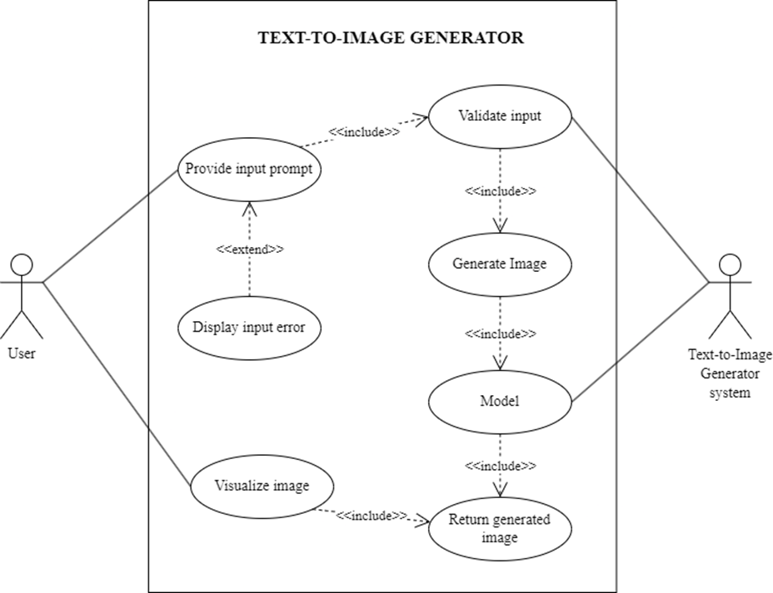
3.1 System Analysis
3.1.1 Requirement Analysis:
3.1.1.i. Functional Requirement
Use Case Diagram
3.1.1.ii. Non-functional Requirement
Performance
Reliability
Usability

Slide 12
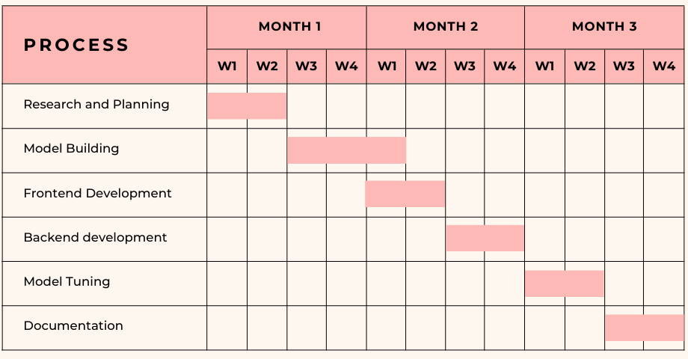
3.1 System Analysis
3.1.2 Feasibility Analysis:
3.1.2.i. Technical Feasibility
3.1.2.ii. Schedule Feasibility
3.1.3.iii. Economic Feasibility

Slide 13
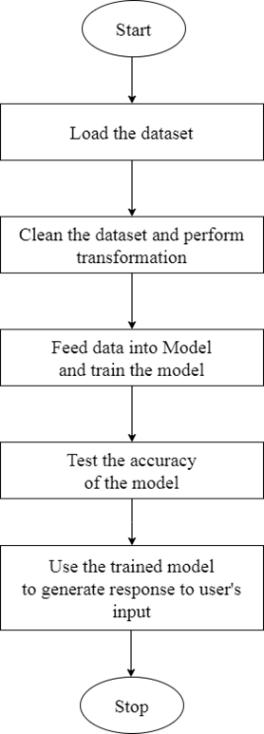
3.1 System Analysis
3.1.3 Analysis:
3.1.3.i. Flow Diagram

Slide 14
CHAPTER - 4:
SYSTEM DESIGN

Slide 15
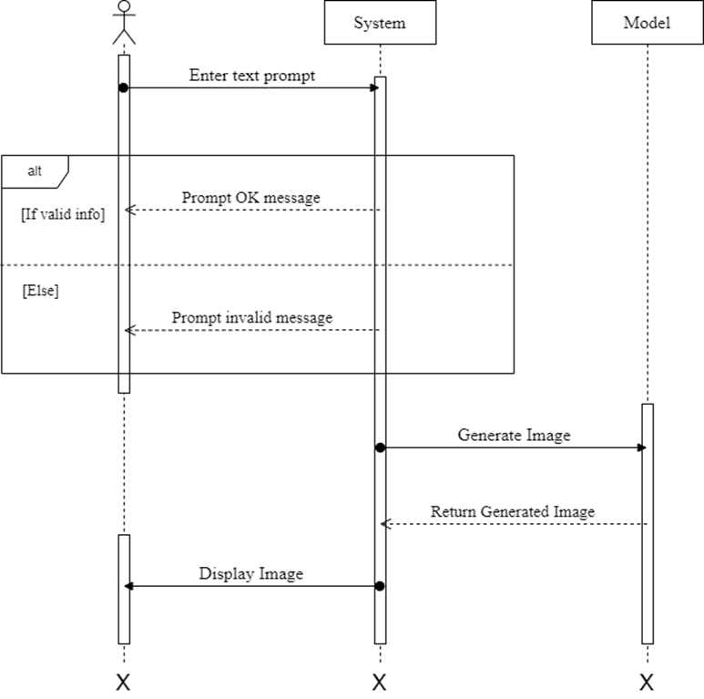
4.1 Design
4.1.1 Sequence Diagram

Slide 16
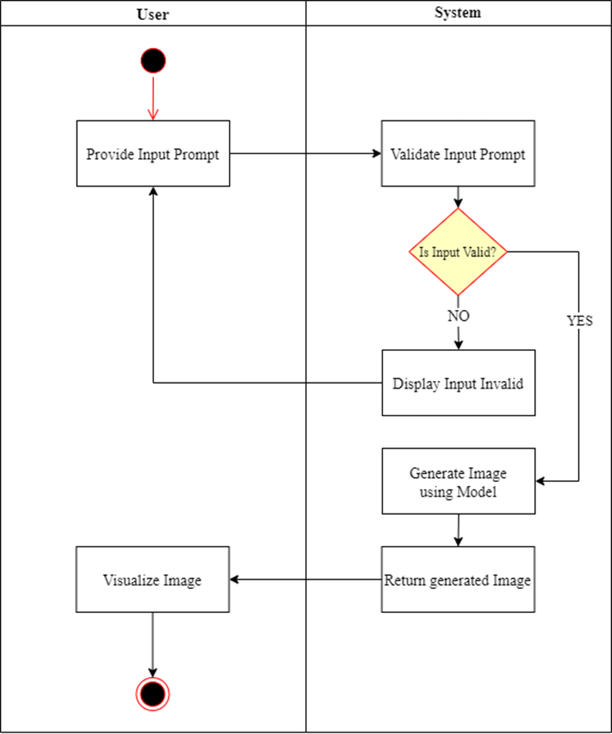
4.1 Design
4.1.2. Activity Diagram

Slide 17
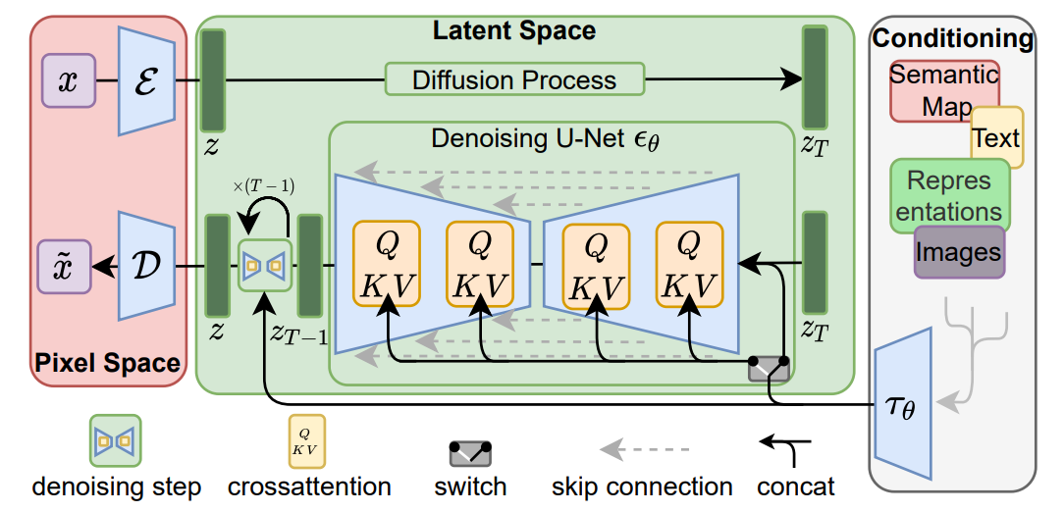
4.2. Algorithm Details
Autoencoder
Gaussian Noise and Forward Diffusion
Denoising U-Net and Reverse Diffusion
Fig: Architecture of the Model

Slide 18
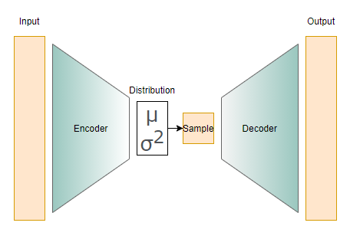
Autoencoder

Slide 19
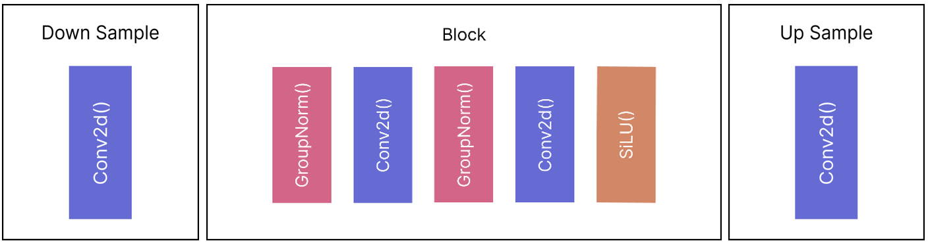
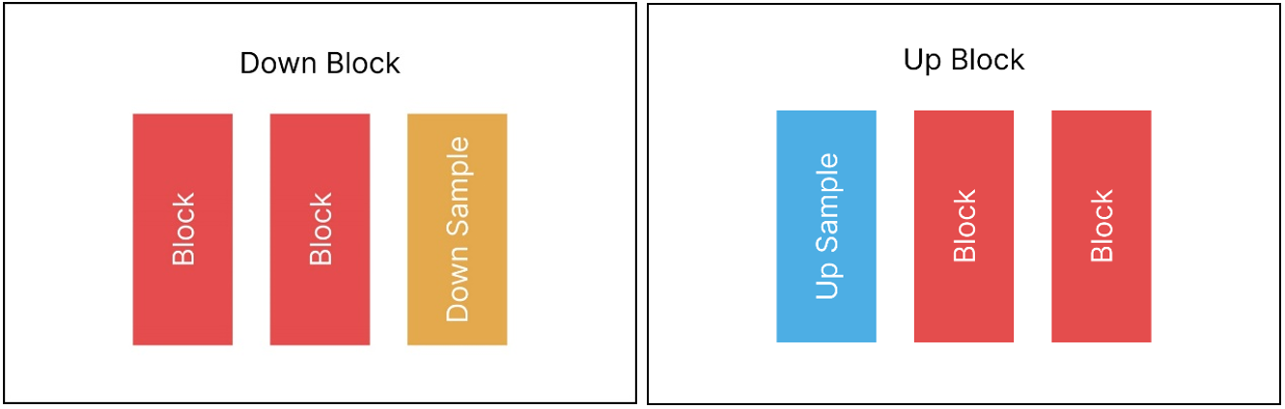

Slide 20
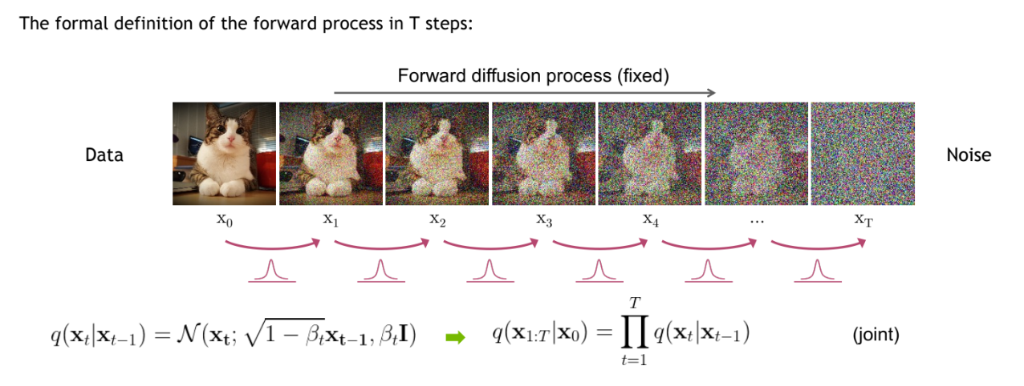
Forward Diffusion Process

Slide 21
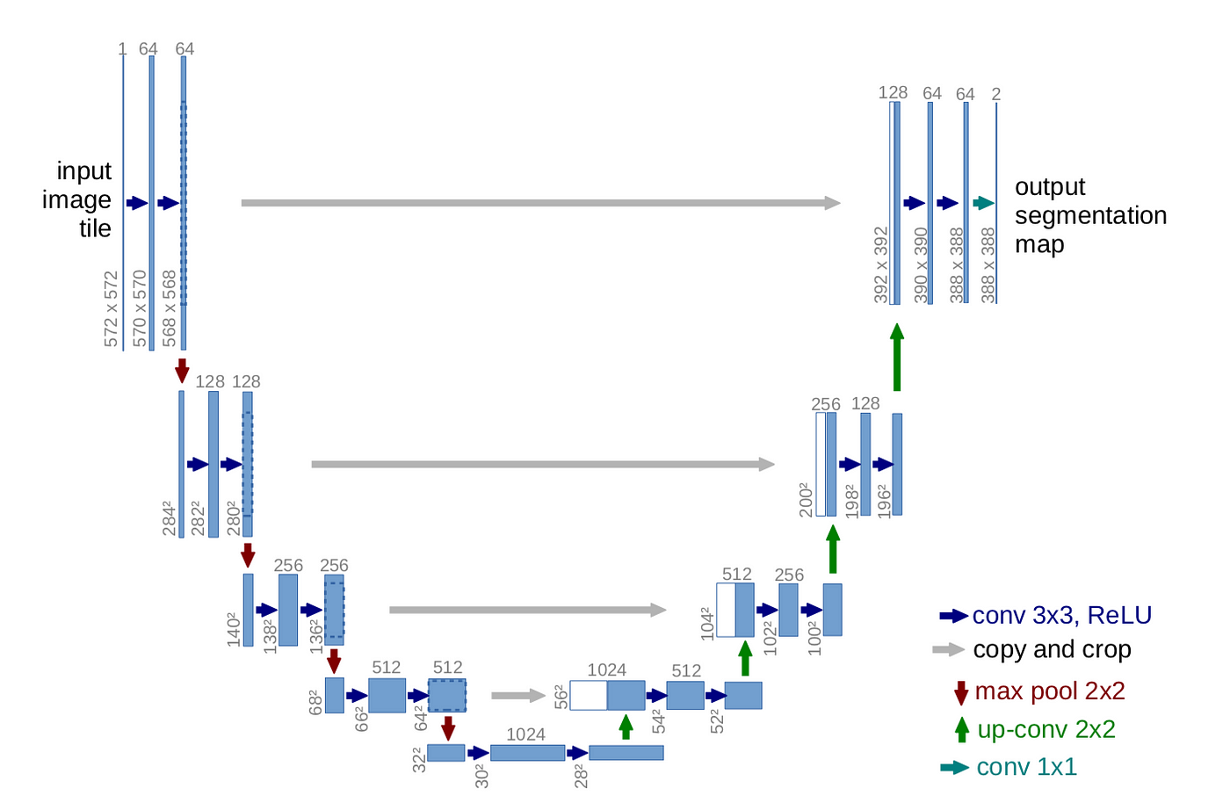
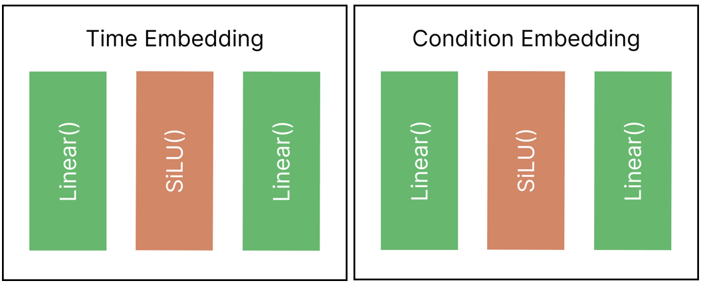
UNet

Slide 22
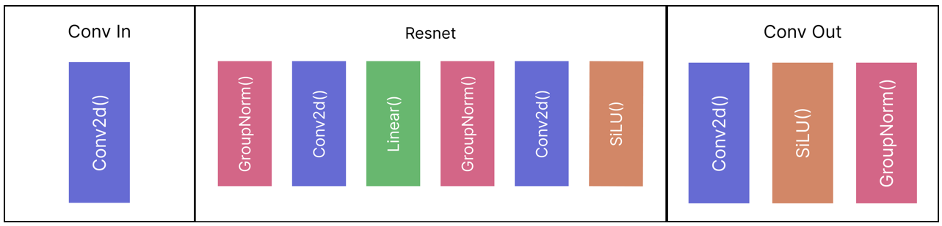
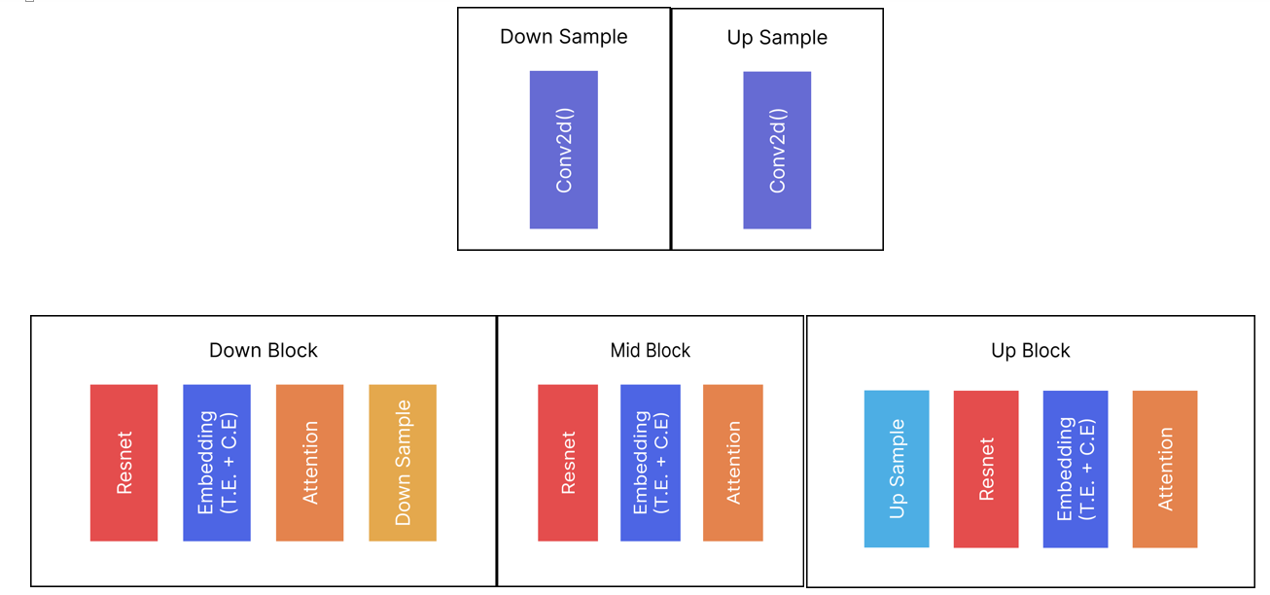

Slide 23
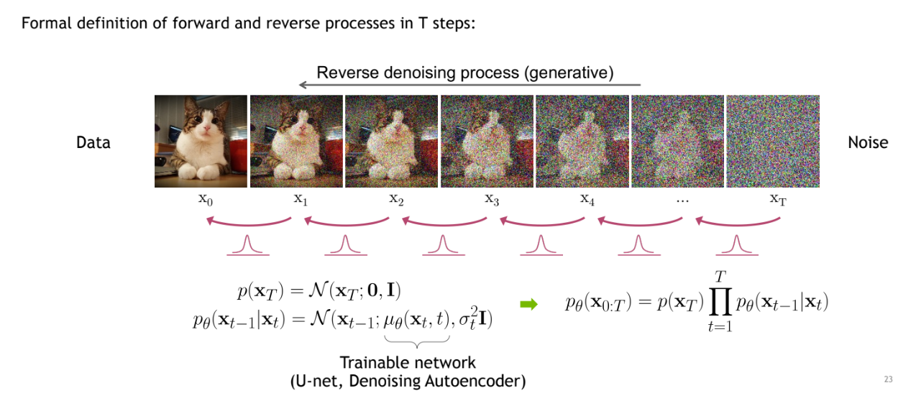
Reverse Diffusion Process

Slide 24
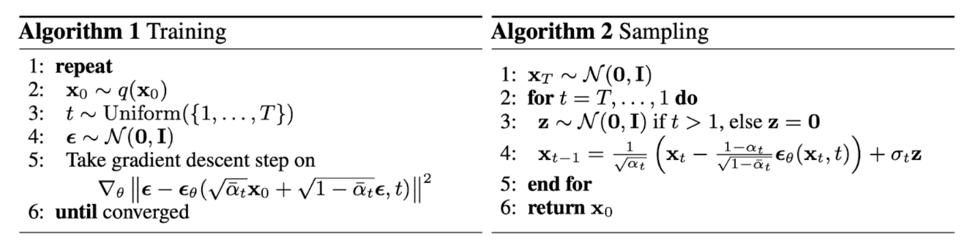

Slide 25
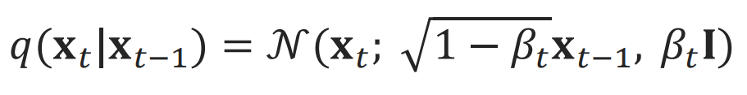
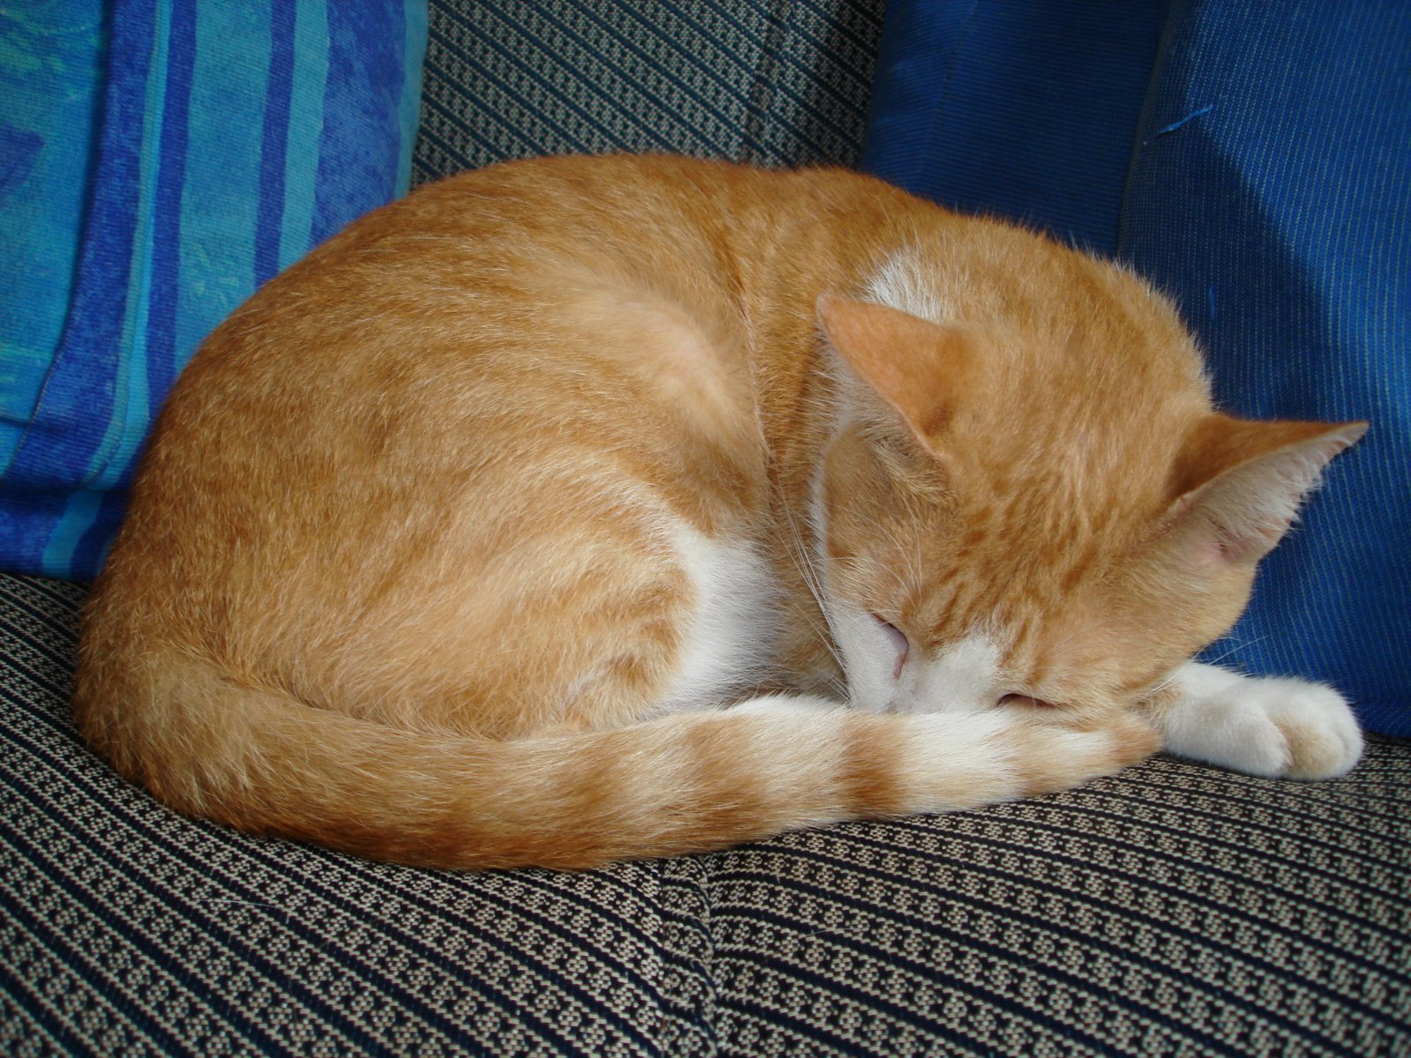
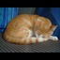
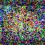
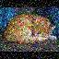
32 X 32
8 times less
Cat
256 X 256
Mean
Variance
Cat = 0
Dog = 1

Slide 26
CHAPTER - 5:
IMPLEMENTATION

Slide 27
5.1.2 IMPLEMENTATION OF MODULES
1. app.py
- Launches Gradio interface for user interaction.
- Dependencies on functionalities provided by 'ldm_module.py'.
2. dataset.py
a. CustomDataset
- Extends PyTorch’s dataset class.
- Handles folder image dataset, providing load and preprocess methods.
b. NumpyDS
- Specialized class for latent images represented as NumPy files.
- Extends 'CustomDataset' for consistent handling.

Slide 28
3. data_preprocessing.py
a. data_to_latents()
- Takes VAE model, data folder, latent folder, and preprocessing parameters.
- Uses 'CustomDataset' and PyTorch's DataLoader for preprocessing.
- Encodes image data with VAE, saves latents in NumPy format.
b. latent_dataloader()
- Loads dataset from latent folder using 'NumpyDS'.
- Utilizes PyTorch's DataLoader for data loading.

Slide 29
4. ldm_module.py
- Manages UNet and VAE instances, loads their weights.
- Uses DDPMSampler with 1000 timesteps for image noising.
- Contains 'generate_image()' function for text-to-image generation.
5. ldm.ipynb
- Jupyter notebook for training purposes.
- Tasks:
- Instantiates UNet, VAE, and DDPMscheduler.
- Utilizes functionalities from 'dataset.py' and 'data_preprocessing.py'.
- Executes PyTorch training loop for 1000 epochs, saving the model.
- Plots training loss.
- Conducts inference, showcasing the generative capabilities of the model.

Slide 30
REFERENCES
[1] Robin Rombach, Andreas Blattmann, Dominik Lorenz, Patrick Esser, Bjorn Ommer, “High-Resolution Image Synthesis with Diffusion Models”, Arxiv, Apr. 13, 2022. [Online]. Available: https://arxiv.org/pdf/2112.10752.pdf
[2] Patrick Esser, Robin Rombach, Bjorn Ommer, “Taming Transformers for High-Resolution Image Synthesis” Arxiv, Dec. 16, 2020. [Online]. Available: https://arxiv.org/pdf/2006.11239.pdf
[3] Jonathan Ho, Ajay Jain and Pieter Abbeel, “Denoising Diffusion Probabilistic Models”, Arxiv, Dec. 16, 2020. [Online]. Available: https://arxiv.org/pdf/2006.11239.pdf
[4] Olaf Ronneberger, Philipp Fischer and Thomas Brox, “U-Net: Convolutional Networks for Biomedical Image Segmentation”, Arxiv, May. 18, 2015. [Online]. Available: https://arxiv.org/pdf/1505.04597.pdf
[5] Alex Nichol and Prafulla Dhariwal, “Improved Denoising Diffusion Probabilistic Models,” Feb. 2021. [Online]. Available: https://arxiv.org/pdf/2102.09672.pdf
[6] J. Sohl-Dickstein, E. Weiss, N. Maheswaranathan, S. Ganguli, and S. Edu, “Deep Unsupervised Learning using Nonequilibrium Thermodynamics,” Nov. 2015. Available: https://arxiv.org/pdf/1503.03585.pdf

